Slide 1

INDUSTRIAL SOLUTIONS
homsunlift Solid Tires
Heavy-duty tires, factory direct, global certified
ISO 9001
Exporting
5-year warranty
Notes:
各位尊敬的客户大家好，欢迎来到鼎固轮胎产品解决方案分享会。我是鼎固轮胎的产品顾问，今天将为大家详细介绍我们专为工业叉车打造的高性能实心轮胎系列产品。鼎固深耕轮胎行业多年，致力于为客户提供高承重、强耐磨的实心轮胎解决方案，帮助客户降低运营成本、提升作业效率。

Slide 2
01
Robust
Contents
02
Superior Quality
Contents
Dinggu Forklift Tires: Strong, Reliable, High-Quality.
Business architecture: trends, uses, systems.
03
Use cases
04
Service System
Notes:
今天的分享将分为四个主要部分。首先我会介绍鼎固轮胎的企业实力与资质认证，让大家了解我们的可靠性；然后详细讲解实心轮胎的核心技术优势；接着展示产品在不同工业场景中的应用；最后说明我们的服务体系与保障政策。整个分享大约需要15分钟，期间大家可以随时提问。

Slide 3
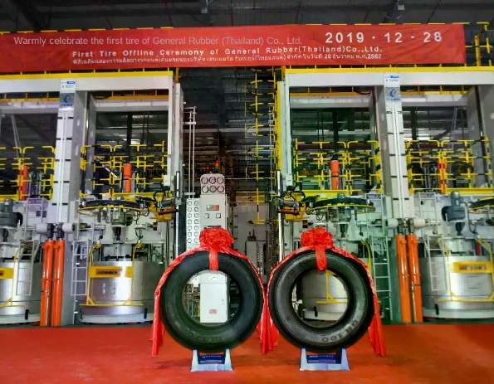
Enterprise Strength
Strong Tire Manufacturer
Full-category coverage
We supply agricultural, industrial, off-road, and specialty tires.
We supply hard-to-find tires and wheels with matching services.
Global certification standard
Certified: CCC, ISO, SGS, BV, INMETRO, SIRIM, ECE, SNI.
Over ten global certifications support export compliance.
Multi-Channel Support
We serve tire makers with tires and rims, and support institutions with quotes and invoices.
One-stop export services: LCL, trailer, customs, warehousing.
Tire Plant & Factory Environment
Core advantages: homsunlift.com Tire supplies industrial tires with global certifications and a full-service system from R&D to export.
We’re authorized to offer tailored solutions for equipment makers, institutions, and traders, with products sold globally.
Notes:
鼎固轮胎有限公司是一家专注工业轮胎研发与制造的供应商。我们不仅提供叉车实心轮胎，还覆盖农用胎、工程胎、装载机轮胎等全系列产品。特别值得一提的是，我们拥有CCC、ISO、SGS、BV、INMETRO等十余项国际权威认证，这意味着我们的产品质量符合全球各主要市场的准入标准。无论您是国内工厂采购还是出口贸易，我们都能提供相应的资质支持。

Slide 4
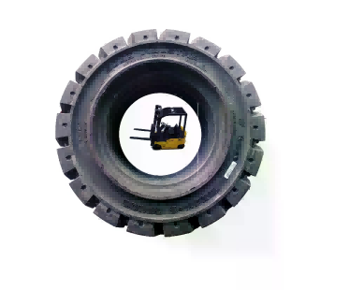
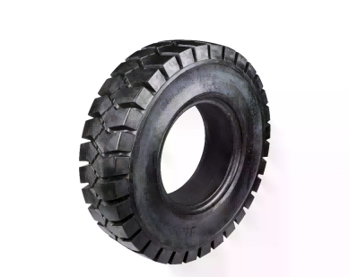
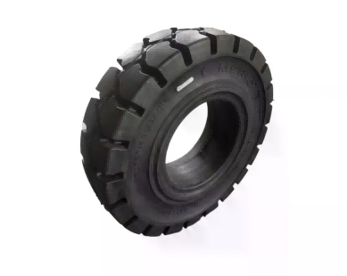
CORE ADVANTAGES
Core advantages of solid tires
We optimized tread compound and deep pattern for forklifts (3–3.5 tons) with high load, strong grip, shock absorption, and wear resistance to ensure stable, efficient performance in tough industrial settings.
SECTION 01
SECTION 02
SECTION 03
Heavy duty · Secure grip
Cushioned. Durable.
Complete coverage
Reinforced tire supports 3–3.5 tons load.
Demand
Solid tires absorb vibrations, reducing shocks during forklift use.
Impact vibration
Compatible with 3–3.5-ton forklifts.
ton-class vehicle
Special rubber works on cement, steel, and gravel.
Stable traction in all conditions.
Durable formula and thick tread last longer, resist punctures.
Nail & tire blowout downtime risk
Two options: steel belt or separate carcass, fits 18x7-8.
Custom specs
Notes:
接下来我们看看鼎固实心轮胎的核心竞争力。首先，高承重与强抓地是我们产品的基本功。采用特殊胎面配方与深花纹设计，确保3吨到3.5吨叉车在满载作业时依然保持稳定牵引力。其次，强缓震与久耐磨特性意味着轮胎在复杂路况下能有效吸收冲击，同时胎面磨损速度显著低于普通充气胎，大幅降低更换频率。最后，我们提供650-10、28x9-15等全系列规格，适配杭叉、合力等主流品牌。

Slide 5
Technical Specifications
Main Product Technical Specifications
homsunlift's solid tires match 650-10 and 28x9-15 specs for 3–3.5 ton forklifts, plus smaller sizes like 18x7-8 and special industrial needs, offering a full range.
Complete industrial tire range.
Dinggu Forklift Tire Specs
Model Spec | Rim size | Level carry | Global | Vehicles
650-10 | 6.00 | 3.0-3.5ton | Rear wheel | 3t/3.5t
28x9-15 | 7.00 | 3.0-3.5ton | Front wheel | 3t/3.5t
18x7-8 | 4.33 | 1.5-2.0ton | Wheels | Small electric forklifts
180/70-8/4.33 | 4.33 | 1.5ton | Wheels | Custom industrial vehicles
650-10 Specs
28x9-15 specification
18x7-8 specification
6-inch rims, rear wheels, 3–3.5 ton forklifts, tread width and depth specified
Balance wear and rolling resistance.
Front-wheel standard, 650-10 rear, Hangcha compatible.
Heli and other top forklifts
Special sizes for small forklifts.
Customized production
Notes:
这里是我们主力产品的技术参数表。可以看到650-10这个规格主要适用于3吨叉车的后轮，搭配6.00轮辋；而28x9-15则多用于前轮。这两个规格是杭叉、合力等主流品牌3吨级叉车的标准配置。此外我们也提供18x7-8等小型规格以及180/70-8等特殊尺寸。所有产品均执行国家标准，并提供正品三包保障。

Slide 6
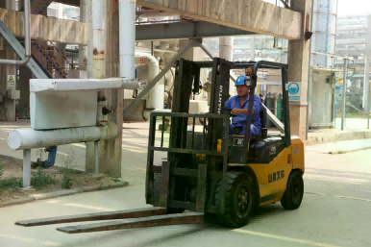
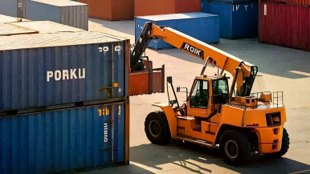
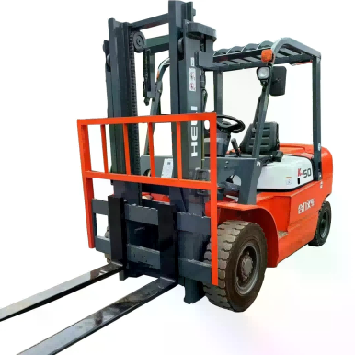
APPLICATION SCENARIOS
Wide-ranging uses
homsunlift solid forklift tires suit various environments, from heavy industry to precise logistics.
LOGISTICS
INDUSTRIAL
Logistics & Warehousing
Industrial zone
Airport, port, and warehouse material handling.
High tire stability and maintenance-free solid tires cut costs.
Yes.
Coal mines, steel plants, foundries have complex, metal-rich grounds.
Solid tires resist debris and heat, no blowouts.
High-frequency areas: factories, warehouses, mills.
Tire wear affects equipment use and efficiency.
SPECIAL
Solid tires for harsh environments like scrap yards.
Puncture resistance cuts tire replacements and downtime.
Hazardous workplace
durable sidewalls for rough terrain.
Solid tires absorb bumps, reducing vibration.
Go.
Notes:
鼎固实心轮胎的应用场景非常广泛。第一类是重工业环境，比如煤矿和钢铁厂，这些地方路面条件差、载重需求高，实心胎的耐扎耐磨特性正好发挥优势。第二类是物流仓储领域，包括机场行李搬运、港口集装箱装卸、仓库物资转运，这些场景对轮胎的静音性和地面保护有较高要求。第三类是特殊作业环境，比如建筑工地的碎石路面、食品厂的洁净地面、垃圾场的尖锐杂物路面，实心胎都能稳定应对。

Slide 7
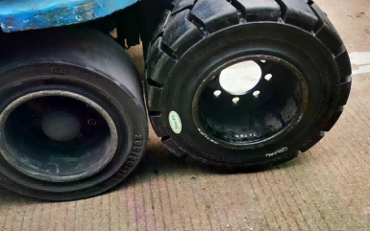
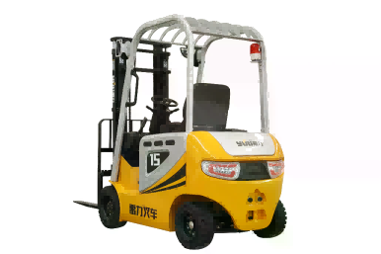
CORE ADVANTAGES
Solid vs. Inflatable Tires: Key Benefits
Dinggu solid tires offer better safety and cost savings vs. pneumatic tires in forklifts.
SAFETY
ECONOMY
MAINTENANCE
Zero blowout risk
Lower costs, better efficiency
No maintenance needed
30%+
Long-lasting
¥200+
Cost reduction
Lifespan up 30%, lower tire costs.
Solid tires avoid punctures and sudden pressure loss.
Risk
Factory sales: 200+ yuan cheaper.
Low maintenance, ideal for large fleets.
Pneumatic tires prone to punctures; solid tires safer.
Full margin
No more frequent tire changes—handles nails easily!
Solid tires last 30% longer, need no maintenance, and cut total costs by 20% to 40%.
Notes:
很多朋友关心实心胎和充气胎到底该怎么选。从安全性角度看，实心胎最大的优势就是不怕扎——无论是钉子、碎玻璃还是金属屑，都不会导致轮胎突然失效，这对于连续作业的工业环境至关重要。从经济性角度看，虽然实心胎 upfront cost 稍高，但按使用寿命折算，日均成本反而更低，而且省去了频繁补胎、换胎的停工损失。从维护角度看，实心胎基本免维护，不需要定期检查气压，特别适合车队规模较大的企业。

Slide 8
CUSTOMER FEEDBACK
Real customer thoughts
homsunlift solid tires praised for durability, perfect fit, puncture resistance, and great value in real industrial use.
High repeat buyers confirm product reliability through follow-up reviews.
Quality verified.
Awarded for safety
Tires feel great, fit perfectly, made with thick, high-quality materials.
"Error" means standards are met.
Solid tires eliminate fear of nails and blowouts.
Puncture resistance tested in tough conditions.
User feedback
Safe operation practiced.
Big savings
Trust over time
Save 200+ yuan per tire, even a full set with electric tools. Factory direct!
Pricing and easy assembly praised.
High repeat buyers and long-term follow-up cases.
Durable and long-lasting.
Cost Comparison
Repurchase & Review Data
Notes:
这里分享一些真实用户的反馈。有客户评价说'轮胎用料厚实，尺寸标准，装车贴合'，这说明我们的产品在制造工艺上确实经得起检验。还有用户特别提到'再也不怕被钉子扎了，目前没有开裂脱胶的问题'，这正是实心胎的核心价值所在。更有客户算了笔经济账，说'比实体店便宜200多一条，自装两条胎电动工具都省一套出来'。这些反馈来自复购多次的老客户，包括标注'买过5次'的资深用户，说明产品质量确实得到了长期验证。

Slide 9
SERVICE SYSTEM
Full-service system
Complete service from pre-sale to post-sale support.
Direct factory pricing
Authentic, Guaranteed, Quality Assured
Direct sales cut costs, lowering prices vs. physical stores.Over 200 yuansame
Quality first, cost-effective results.
We guarantee quality and handle issues promptly.Original Three-GuaranteeEffective
Lower risks, build trust, sustain partnerships.
Certification & Export Help
Trade support
To haveCCC, ISO, SGS, BV, INMETROOver 10 international certs for major markets.
Platform supports export compliance and aids global expansion.
Trade partnersTrailer, customs, yard, consolidationStreamline exports with one-stop logistics.
Simplify processes, boost supply chain efficiency, ensure smooth customs clearance.
Notes:
最后介绍一下我们的服务体系。首先是工厂直销模式，没有中间商环节，确保价格竞争力与快速响应。其次是正品三包承诺，我们对产品质量有信心，提供完善的售后保障。对于有出口需求的客户，我们支持CCC、ISO、SGS等十余项国际认证，并提供拼柜、拖车、报关等一站式服务。无论您是终端工厂、设备制造商还是贸易公司，我们都能匹配相应的服务方案。

Slide 10

homsunlift Tire:
Industrial Strength
Heavy-duty · Secure · Cushioned
Strong and long-lasting
Direct factory sales, global certification, genuine with guarantees
Get manual and quote—contact us.
Official website:https://www.homsunlift.com
WhatsApp/Wechat ID:+8613680275183
Email:sandy519@foxmail.com
Notes:
以上就是今天关于鼎固叉车实心轮胎解决方案的完整分享。我们回顾了鼎固的企业实力、产品四大核心优势、多元化应用场景、与充气胎的对比价值，以及我们的服务体系。实心轮胎在工业叉车领域确实能带来更高的安全性、更低的综合成本和更少的维护烦恼。如果您对我们的产品感兴趣，或者有任何特殊规格需求，欢迎随时联系。鼎固轮胎，工业级品质的可靠选择。谢谢大家！

